Slide 1
Installing Tomcat Web Server on EC2

Slide 2
Pre-requisites
Create an Amazon Linux EC2 instance with default configurations
Make sure to create a key pair (or use an existing one) and to keep port 80 open
Use putty to connect to the EC2 instance, user name will be ec2-user

Slide 3
Downloading and Installing Tomcat
Install Java
yum install java-1.8* (or sudo yum install java-1.8*)
Install Tomcat
sudo su -
cd /
cd /opt
#Download tomcat binary
wget https://dlcdn.apache.org/tomcat/tomcat-9/v9.0.68/bin/apache-tomcat-9.0.68.tar.gz
#unzip tomcat binary
tar -zvxf apache-tomcat-9.0.68.tar.gz

Slide 4
Downloading and Installing Tomcat
Add permissions to start and stop Tomcat
cd apache-tomcat-9.0.68
cd bin
chmod +x startup.sh
chmod +x shutdown.sh
Change Tomcat port number from 8080 to 80
cd ..
cd conf
nano server.xml (Here look for 8080 and change it to 80) then Ctrl+X
cd ..
cd bin
./startup.sh

Slide 5
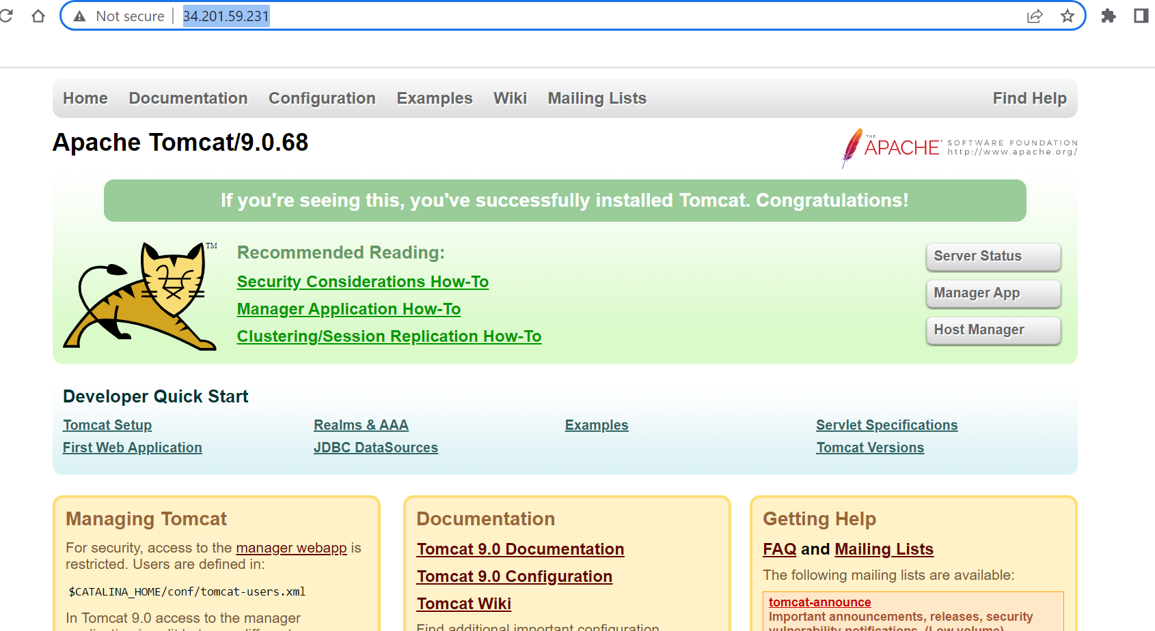
Test: Open Browser and Specify the URL
http://34.201.59.231:80

